Slide 1
Healthcare Database System
-Krish Vanza (23CSB0B62)
-Shubh Gupta (23CSB0F33)
-Harshit Yadav (23CSB0B12)

Slide 2
Contents
1. Tables & Basic Triggers
2. Sample Data (INSERT statements)
3. CRUD & Analytical Queries
4. ER Diagram

Slide 3
Problem Statement
Hospitals manage large volumes of patient, doctor, and treatment data, often leading to errors, delays, and inefficiencies when handled manually.
This project aims to build a centralized database system that ensures accurate, secure, and real-time management of healthcare data.
It streamlines operations like appointments, prescriptions, and billing while maintaining data integrity and accountability through triggers and role-based updates.

Slide 4
Assumptions Made
Each patient can have multiple appointments and multiple medical records over time.
A doctor may treat many patients and be responsible for multiple prescriptions.
Only authorized users (e.g., admin, clerk, nurse) will interact with the system via a front-end application.
User roles are managed externally (outside this schema, by views) and passed into the database for auditing (UpdatedBy).
Only current hospital staff (doctors in the Doctors table) can create or update medical records.
Departments are fixed and centrally managed; new departments are rarely added.
Each prescription is linked to one medication per medical record entry (1:1:1).
The database assumes no concurrency control at this level (handled by the application layer).

Slide 5
Database Tables / Entity Set
1. Patients
2. Departments
3. Doctors
4. Appointments
5. MedicalRecords
6. Medications
7. Prescriptions
8. Billing

Slide 6
Basic Triggers
trg_check_dob - Ensures DOB is not in future
trg_check_appointment_date - Prevents past appointments
trg_patients_usercheck – Automatically Sets User And Update Time.

Slide 7
-- 1. Patients Table
CREATE TABLE Patients (
PatientID INT PRIMARY KEY,
FullName VARCHAR2(100) NOT NULL,
DOB DATE,
Gender CHAR(1) CHECK (Gender IN ('M', 'F')),
ContactNumber VARCHAR2(15) CHECK (LENGTH(ContactNumber) BETWEEN 10 AND 15),
LastUpdated TIMESTAMP DEFAULT CURRENT_TIMESTAMP,
UpdatedBy VARCHAR2(100)
);
-- Trigger to validate DOB
CREATE OR REPLACE TRIGGER trg_check_dob
BEFORE INSERT OR UPDATE ON Patients
FOR EACH ROW
BEGIN
IF :NEW.DOB > SYSDATE THEN
RAISE_APPLICATION_ERROR(-20001, 'DOB cannot be in the future.');
END IF;
END;
/
-- 2. Departments Table
CREATE TABLE Departments (
DepartmentID INT PRIMARY KEY,
DepartmentName VARCHAR2(50) NOT NULL CHECK (DepartmentName IN (
'Cardiology', 'Neurology', 'Pediatrics', 'Orthopedics', 'Oncology', 'Emergency'
)),
HeadDoctorID INT,
LastUpdated TIMESTAMP DEFAULT CURRENT_TIMESTAMP,
UpdatedBy VARCHAR2(100)
);

Slide 8
-- 3. Doctors Table
CREATE TABLE Doctors (
DoctorID INT PRIMARY KEY,
FullName VARCHAR2(100) NOT NULL,
Specialty VARCHAR2(50) NOT NULL,
Phone VARCHAR2(15) CHECK (LENGTH(Phone) BETWEEN 10 AND 15),
DepartmentID INT,
FOREIGN KEY (DepartmentID) REFERENCES Departments(DepartmentID),
LastUpdated TIMESTAMP DEFAULT CURRENT_TIMESTAMP,
UpdatedBy VARCHAR2(100)
);
-- 4. Appointments Table
CREATE TABLE Appointments (
AppointmentID INT PRIMARY KEY,
PatientID INT,
DoctorID INT,
AppointmentDate DATE,
Status VARCHAR2(20) CHECK (Status IN ('Scheduled', 'Completed', 'Cancelled')),
FOREIGN KEY (PatientID) REFERENCES Patients(PatientID),
FOREIGN KEY (DoctorID) REFERENCES Doctors(DoctorID),
LastUpdated TIMESTAMP DEFAULT CURRENT_TIMESTAMP,
UpdatedBy VARCHAR2(100)
);
-- Trigger to validate Appointment Date
CREATE OR REPLACE TRIGGER trg_check_appointment_date
BEFORE INSERT OR UPDATE ON Appointments
FOR EACH ROW
BEGIN
IF :NEW.AppointmentDate < TRUNC(SYSDATE) THEN
RAISE_APPLICATION_ERROR(-20002, 'Appointment date cannot be in the past.');
END IF;
END;
/

Slide 9
-- 5. MedicalRecords Table
CREATE TABLE MedicalRecords (
RecordID INT PRIMARY KEY,
PatientID INT,
DoctorID INT,
Diagnosis CLOB NOT NULL,
FOREIGN KEY (PatientID) REFERENCES Patients(PatientID),
FOREIGN KEY (DoctorID) REFERENCES Doctors(DoctorID),
LastUpdated TIMESTAMP DEFAULT CURRENT_TIMESTAMP,
UpdatedBy VARCHAR2(100)
);
-- 6. Medications Table
CREATE TABLE Medications (
MedicationID INT PRIMARY KEY,
MedicationName VARCHAR2(100) NOT NULL,
LastUpdated TIMESTAMP DEFAULT CURRENT_TIMESTAMP,
UpdatedBy VARCHAR2(100)
);
-- 7. Prescriptions Table
CREATE TABLE Prescriptions (
PrescriptionID INT PRIMARY KEY,
RecordID INT,
MedicationID INT,
FOREIGN KEY (RecordID) REFERENCES MedicalRecords(RecordID),
FOREIGN KEY (MedicationID) REFERENCES Medications(MedicationID),
LastUpdated TIMESTAMP DEFAULT CURRENT_TIMESTAMP,
UpdatedBy VARCHAR2(100)
);
-- 8. Billing Table
CREATE TABLE Billing (
BillID INT PRIMARY KEY,
PatientID INT,
Amount NUMBER(10, 2) CHECK (Amount >= 0),
BillingDate DATE NOT NULL,
PaymentStatus VARCHAR2(20) CHECK (PaymentStatus IN ('Pending', 'Paid', 'Cancelled')),
FOREIGN KEY (PatientID) REFERENCES Patients(PatientID),
LastUpdated TIMESTAMP DEFAULT CURRENT_TIMESTAMP,
UpdatedBy VARCHAR2(100)
);

Slide 10
Initial INSERTs
INSERT INTO Departments VALUES (1, 'Cardiology', NULL, CURRENT_TIMESTAMP, 'admin');
INSERT INTO Departments VALUES (2, 'Neurology', NULL, CURRENT_TIMESTAMP, 'admin');
INSERT INTO Departments VALUES (3, 'Pediatrics', NULL, CURRENT_TIMESTAMP, 'admin');
INSERT INTO Departments VALUES (4, 'Orthopedics', NULL, CURRENT_TIMESTAMP, 'admin');
INSERT INTO Departments VALUES (5, 'Oncology', NULL, CURRENT_TIMESTAMP, 'admin’);
INSERT INTO Doctors VALUES (101,'Dr. Mehta','Cardiologist','9876543210',1,CURRENT_TIMESTAMP,'admin');
INSERT INTO Doctors VALUES (102,'Dr. Nair','Neurologist','9123456789',2,CURRENT_TIMESTAMP,'admin');
INSERT INTO Doctors VALUES (103,'Dr. Khan','Pediatrician','9012345678',3,CURRENT_TIMESTAMP,'admin');
INSERT INTO Doctors VALUES (104,'Dr. Bose','Orthopedic','8899001122',4,CURRENT_TIMESTAMP,'admin');
INSERT INTO Doctors VALUES (105,'Dr. Dutta’,'Oncologist','9001112233',5,CURRENT_TIMESTAMP,'admin’);
INSERT INTO Patients VALUES (201, 'Ananya Sharma', TO_DATE('2000-05-15', 'YYYY-MM-DD'), 'F', '9999988888', CURRENT_TIMESTAMP, 'admin');
INSERT INTO Patients VALUES (202, 'Ravi Kumar', TO_DATE('1985-10-30', 'YYYY-MM-DD'), 'M', '8888877777', CURRENT_TIMESTAMP, 'admin');
INSERT INTO Patients VALUES (203, 'Sneha Roy', TO_DATE('1992-03-12', 'YYYY-MM-DD'), 'F', '7777766666', CURRENT_TIMESTAMP, 'admin');
INSERT INTO Patients VALUES (204, 'Amit Verma', TO_DATE('1978-01-25', 'YYYY-MM-DD'), 'M', '6666655555', CURRENT_TIMESTAMP, 'admin');
INSERT INTO Patients VALUES (205, 'Pooja Das', TO_DATE('2001-12-02', 'YYYY-MM-DD'), 'F', '9999900000', CURRENT_TIMESTAMP, 'admin');
INSERT INTO Patients VALUES (206, 'Krish Vanza', TO_DATE('2005-12-02', 'YYYY-MM-DD'), 'M', '9997800000', CURRENT_TIMESTAMP, 'admin’);

Slide 11
INSERT INTO Appointments VALUES (301, 201, 101, SYSDATE + 1, 'Scheduled', CURRENT_TIMESTAMP, 'admin');
INSERT INTO Appointments VALUES (302, 202, 102, SYSDATE + 2, 'Scheduled', CURRENT_TIMESTAMP, 'admin');
INSERT INTO Appointments VALUES (303, 203, 103, SYSDATE + 3, 'Scheduled', CURRENT_TIMESTAMP, 'admin');
INSERT INTO Appointments VALUES (304, 204, 104, SYSDATE + 4, 'Scheduled', CURRENT_TIMESTAMP, 'admin');
INSERT INTO Appointments VALUES (305, 205, 105, SYSDATE + 5, 'Scheduled', CURRENT_TIMESTAMP, 'admin’);
INSERT INTO MedicalRecords VALUES (401, 201, 101, 'Diagnosed with hypertension.', CURRENT_TIMESTAMP, 'admin');
INSERT INTO MedicalRecords VALUES (402, 202, 102, 'Migraines under observation.', CURRENT_TIMESTAMP, 'admin');
INSERT INTO MedicalRecords VALUES (403, 203, 103, 'Routine child checkup.', CURRENT_TIMESTAMP, 'admin');
INSERT INTO MedicalRecords VALUES (404, 204, 104, 'Fracture treatment completed.', CURRENT_TIMESTAMP, 'admin');
INSERT INTO MedicalRecords VALUES (405, 205, 105, 'Chemotherapy ongoing.', CURRENT_TIMESTAMP, 'admin');

Slide 12
INSERT INTO Prescriptions VALUES (601, 401, 501, CURRENT_TIMESTAMP, 'admin');
INSERT INTO Prescriptions VALUES (602, 402, 502, CURRENT_TIMESTAMP, 'admin');
INSERT INTO Prescriptions VALUES (603, 403, 503, CURRENT_TIMESTAMP, 'admin');
INSERT INTO Prescriptions VALUES (604, 404, 504, CURRENT_TIMESTAMP, 'admin');
INSERT INTO Prescriptions VALUES (605, 405, 505, CURRENT_TIMESTAMP, 'admin');
INSERT INTO Billing VALUES (701, 201, 1200.00, SYSDATE, 'Pending', CURRENT_TIMESTAMP, 'admin');
INSERT INTO Billing VALUES (702, 202, 950.00, SYSDATE, 'Paid', CURRENT_TIMESTAMP, 'admin');
INSERT INTO Billing VALUES (703, 203, 400.00, SYSDATE, 'Cancelled', CURRENT_TIMESTAMP, 'admin');
INSERT INTO Billing VALUES (704, 204, 1500.00, SYSDATE, 'Pending', CURRENT_TIMESTAMP, 'admin');
INSERT INTO Billing VALUES (705, 205, 2000.00, SYSDATE, 'Paid', CURRENT_TIMESTAMP, 'admin');

Slide 13
Based on USER
CREATE OR REPLACE TRIGGER trg_patients_usercheck
BEFORE INSERT OR UPDATE ON Patients
FOR EACH ROW
BEGIN
:NEW.LastUpdated := CURRENT_TIMESTAMP;
:NEW.UpdatedBy := USER;
END;
/

Slide 14
CRUD Operations
SELECT: View patients, doctors, billing etc.
UPDATE: Change contact, appointment doctor/status
DELETE: Remove appointments, prescriptions, billing
INSERT: Add new patient, doctor, medication etc.

Slide 15
-- 1. View all patients
SELECT * FROM Patients;
-- 2. View all doctors in the Neurology department
SELECT dr.*
FROM Doctors dr, Departments dp
WHERE dr.DepartmentID = dp.DepartmentID AND dp.DepartmentName = 'Neurology';
-- 3. View all appointments for a specific patient
SELECT * FROM Appointments WHERE PatientID = 201;
-- 4. List all appointments scheduled today or later
SELECT * FROM Appointments WHERE AppointmentDate >= TRUNC(SYSDATE);
-- 5. View billing info of all patients with amount > 1000
SELECT * FROM Billing WHERE Amount > 1000;
-- 6. Update contact number of a patient
UPDATE Patients SET ContactNumber = '9000000001', UpdatedBy = 'admin' WHERE PatientID = 201;
-- 7. Change doctor for an appointment
UPDATE Appointments SET DoctorID = 103, UpdatedBy = 'admin' WHERE AppointmentID = 302;
-- 8. Mark appointment as completed
UPDATE Appointments SET Status = 'Completed', UpdatedBy = 'admin' WHERE AppointmentID = 301;
-- 9. Cancel an appointment
UPDATE Appointments SET Status = 'Cancelled', UpdatedBy = 'admin' WHERE AppointmentID = 303;
-- 10. Delete a billing record
DELETE FROM Billing WHERE BillID = 705;

Slide 16
-- 11. Delete a prescription entry
DELETE FROM Prescriptions WHERE PrescriptionID = 605;
-- 12. Add a new patient
INSERT INTO Patients VALUES (206, 'Kiran Patel', TO_DATE('1990-11-20','YYYY-MM-DD'), 'M', '9876541230', CURRENT_TIMESTAMP, 'admin');
-- 13. Add a new doctor
INSERT INTO Doctors VALUES (106, 'Dr. Rao', 'Physician', '9011223344', 1, CURRENT_TIMESTAMP, 'admin');
-- 14. Schedule a new appointment
INSERT INTO Appointments VALUES (306, 206, 106, SYSDATE + 2, 'Scheduled', CURRENT_TIMESTAMP, 'admin');
-- 15. Add a new medication
INSERT INTO Medications VALUES (506, 'Losartan', CURRENT_TIMESTAMP, 'admin');
-- 16. Add a medical record for a new patient
INSERT INTO MedicalRecords VALUES (406, 206, 106, 'Routine Checkup', CURRENT_TIMESTAMP, 'admin');
-- 17. Assign prescription
INSERT INTO Prescriptions VALUES (606, 406, 506, CURRENT_TIMESTAMP, 'admin');
-- 18. Insert billing info
INSERT INTO Billing VALUES (706, 206, 800.00, SYSDATE, 'Pending', CURRENT_TIMESTAMP, 'admin');

Slide 17
Analytical Queries
Total patients, appointments by status
Billing summary by patient/payment status
Doctors with patient count
Doctors without appointments
Prescriptions for a patient
Department-wise doctor count

Slide 18
-- 19. Count total patients
SELECT COUNT(*) FROM Patients;
-- 20. Count total appointments per status
SELECT Status, COUNT(*) FROM Appointments GROUP BY Status;
-- 21. Total billing amount per patient
SELECT PatientID, SUM(Amount) AS Total_Billed FROM Billing GROUP BY PatientID;
-- 22. List doctors with number of patients they treated (from records)
SELECT DoctorID, COUNT(DISTINCT PatientID) AS PatientCount FROM MedicalRecords GROUP BY DoctorID;
-- 23. Show patients with no billing yet
SELECT * FROM Patients WHERE PatientID NOT IN (SELECT DISTINCT PatientID FROM Billing);
-- 24. Show doctors without appointments
SELECT * FROM Doctors WHERE DoctorID NOT IN (SELECT DISTINCT DoctorID FROM Appointments);
-- 25. Fetch medication prescribed to a patient
SELECT p.PatientID, m.MedicationName
FROM Prescriptions pr, MedicalRecords mr, Medications m, Patients p
WHERE pr.RecordID = mr.RecordID
AND pr.MedicationID = m.MedicationID
AND mr.PatientID = p.PatientID
AND p.PatientID = 201;
-- 26. Show department and count of doctors
SELECT dp.DepartmentName, COUNT(*) AS DoctorCount
FROM Doctors d, Departments dp
WHERE d.DepartmentID = dp.DepartmentID
GROUP BY dp.DepartmentName;
-- 27. List of appointments in next 5 days
SELECT * FROM Appointments WHERE AppointmentDate BETWEEN SYSDATE AND SYSDATE + 5;

Slide 19
-- 28. Find the most recent billing entry
SELECT * FROM Billing ORDER BY BillingDate DESC FETCH FIRST 1 ROWS ONLY;
-- 29. Get patients whose contact starts with '9'
SELECT * FROM Patients WHERE ContactNumber LIKE '9%';
-- 30. Count total prescriptions issued
SELECT COUNT(*) AS TotalPrescriptions FROM Prescriptions;
-- 31. Total amount billed by payment status
SELECT PaymentStatus, SUM(Amount) FROM Billing GROUP BY PaymentStatus;
-- 32. Delete an appointment (if needed)
DELETE FROM Appointments WHERE AppointmentID = 306;
-- 33. Update department name (e.g., correction)
UPDATE Departments SET DepartmentName = 'General Medicine' WHERE DepartmentName = 'Cardiology';
-- 34. Delete a medication
DELETE FROM Medications WHERE MedicationID = 506;
-- 35. Show all prescriptions for patient 201
SELECT pr.*
FROM Prescriptions pr, MedicalRecords mr
WHERE pr.RecordID = mr.RecordID AND mr.PatientID = 201;

Slide 20
Normalization
First Normal Form (1NF) – ensure atomicity :
Each appointment, medication, or diagnosis is stored in a separate row rather than grouped lists.
Second Normal Form (2NF) – Remove partial dependencies
By Making each table have a single-column primary key
.
Appointments(AppointmentID, PatientID, DoctorID, AppointmentDates)
To
Appointments(AppointmentID, PatientID, DoctorID, AppointmentDate)
Appointments(PatientID, DoctorID, AppointmentDate)
To
Appointments(AppointmentID, PatientID, DoctorID, AppointmentDate)

Slide 21
3) Third Normal Form (3NF) – Remove transitive dependencies
Separating DepartmentName into its own Departments table.
Doctors(DoctorID, FullName, Specialty, DepartmentName)
To
Doctors(DoctorID, FullName, Specialty, DepartmentID)
Departments(DepartmentID, DepartmentName)

Slide 22
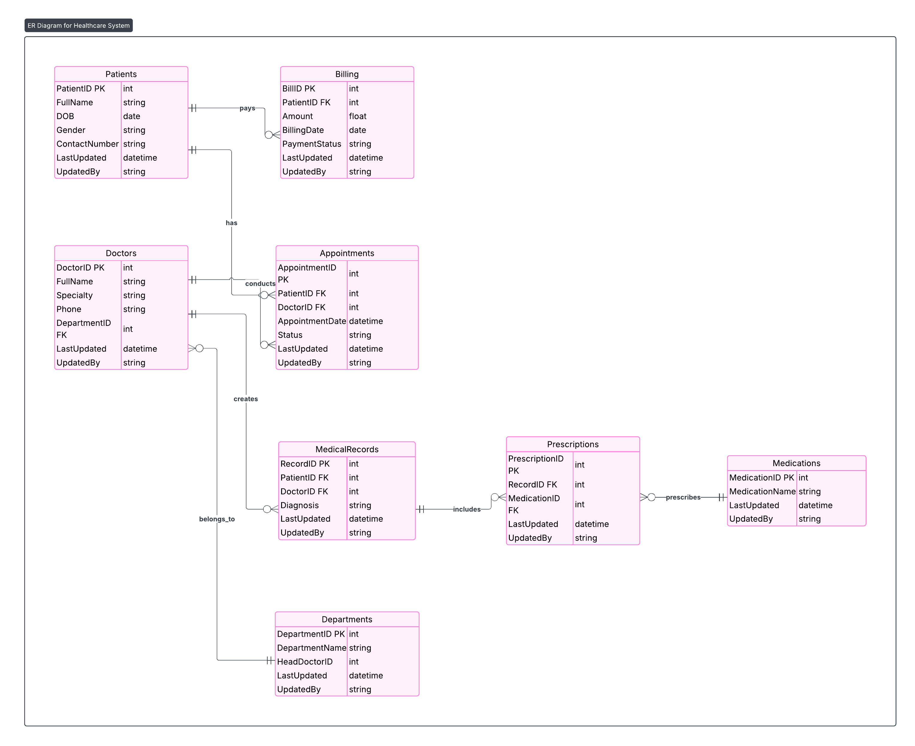

Slide 23
